Slide 1
OCC characteristics of DC generator
Generally, following three characteristics of DC generators are taken into considerations:
(i) Open Circuit Characteristic (O.C.C.), (E₀/I_{f})
(ii) Internal or Total Characteristic and (E/I_{a})
(iii) External Characteristic. (V/I_{L})

Slide 2
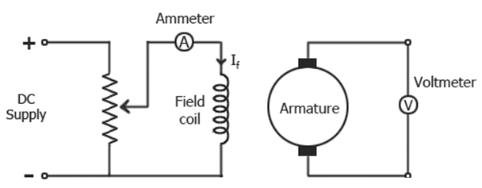
Open Circuit Characteristic (O.C.C.) (E₀/I_{f})
Open circuit characteristic is also known as magnetic characteristic or no-load saturation characteristic.
This characteristic shows the relation between generated emf at no load (E₀) and the field current (I_{f}) at a given fixed speed.
The O.C.C. curve is just the magnetization curve and it is practically similar for all type of generators.
The data for O.C.C. curve is obtained by operating the generator at no load and keeping a constant speed. Field current is gradually increased and the corresponding terminal voltage is recorded.
The connection arrangement to obtain O.C.C. curve is as shown in the figure below

Slide 3
the generated emf should be directly proportional to field flux (and hence, also directly proportional to the field current).
However, even when the field current is zero, some amount of emf is generated (represented by OA in the figure below).
This initially induced emf is due to the fact that there exists some residual magnetism in the field poles. Due to the residual magnetism, a small initial emf is induced in the armature.
This initially induced emf aids the existing residual flux, and hence, increasing the overall field flux. This consequently increases the induced emf.

Slide 4
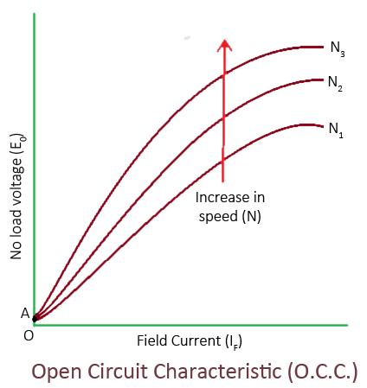
Thus, O.C.C. follows a straight line.
However, as the flux density increases, the poles get saturated and the ɸ becomes practically constant. Thus, even we increase the I_{f} further, ɸ remains constant and hence, Eg also remains constant. Hence, the O.C.C. curve looks like the B-H characteristic.

Slide 5
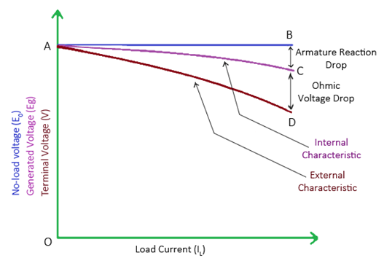
2.Internal or Total Characteristic (E/I_{a})
An internal characteristic curve shows the relation between the on-load generated emf (Eg) and the armature current (I_{a}). The on-load generated emf Eg is always less than E₀ due to the armature reaction.
3. External Characteristic (V/I_{L})
An external characteristic curve shows the relation between terminal voltage (V) and the load current (I_{L}). Terminal voltage V is less than the generated emf Eg due to voltage drop in the armature circuit.

